Slide 1
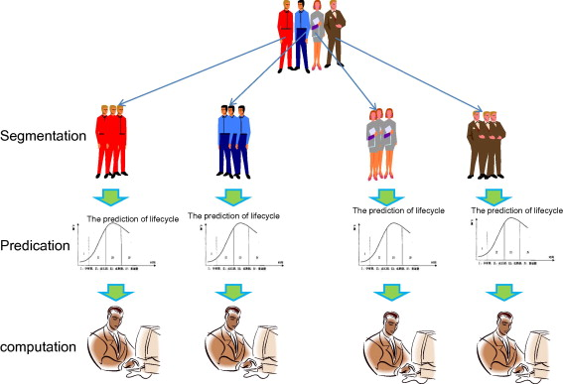



User Analytics in Telecom Industry
Business Case-User Analytics Study in Telecom
GitHub Link- https://github.com/Deb052024/Telecom-Customer-Segment
Name-Debasis Panda

Slide 2
Telco-Analytics Case Flow
User Experience Analytics
Aggregate user based on Average TCP Retransmission, Average RTT, Handset Type and Average Through Put
Listing Top 10 users based on TCP Values ,RTT Values and throughput values
Distribution and TCP Retransmission per handset
K-means to segment user on group of experience
User Overview and Behavior Analysis
User Engagement
User Behavior on XDR sessions
Session Duration
Total Data Down Load and upload
Data Volume during session of application
Univariate and Bivariate Analysis
User Satisfaction
Session Frequency
Duration of session
Session total Traffic (Upload and Download (bytes))
Top 10 engaged customers
K-means Clustering and group users based on engagement metrics
Engagement and Experience Score For User
Satisfaction Score
K means on Engagement and Experience Score
Aggregate the satisfaction and experience score per cluster
Export your final table containing all user ID + engagement, experience & satisfaction scores in local MySQL database.

Slide 3
Case Overview and Objective
Overview:
An investor is interested to purchase a Telco based out in Republic of Pefkakia. This investor’s due diligence on all purchases includes a detailed analysis of the data that underlies the business, to try to understand the fundamentals of the business and especially to identify opportunities to drive profitability by changing the focus of which products or services are being offered.
Telco has deployed Consultant to analyze the System generated data and find insights that will help the investor to take a decision on purchase of the Telco.
Objective:
To analyze a telecommunication dataset that contains useful information about the customers & their activities on the network.
To deliver insights that helps the Investor on the below four parameters :
User Overview Analysis
User Experience Analysis
User Satisfaction Analysis
User Engagement analysis

Slide 4
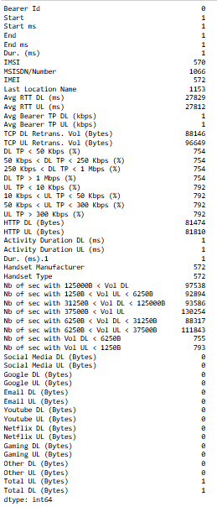
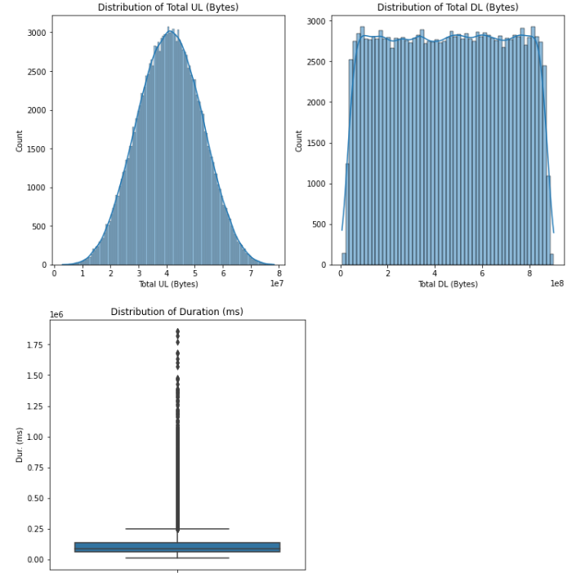
Exploratory and Univariate Analysis on Data
Figure-2
Interpretation
Fig-2: Maximum outlier comes up from Session Duration
Fig-2: Total UL/DL: Skewed distributions suggest most users have relatively low data usage, with a few users responsible for a large portion of the overall data traffic.
Fig-1: Null values present in the data Frame and the Number data Type Features null values were replaced with Mean and Object Data Type Features Null values were replaced with Mode
Figure-1

Slide 5
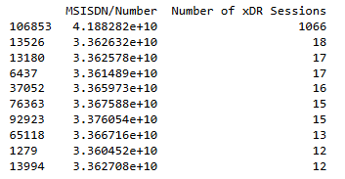
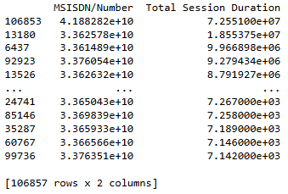
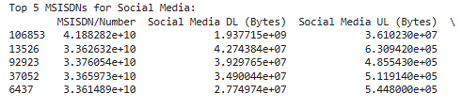
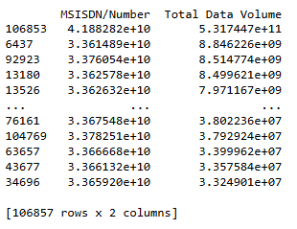
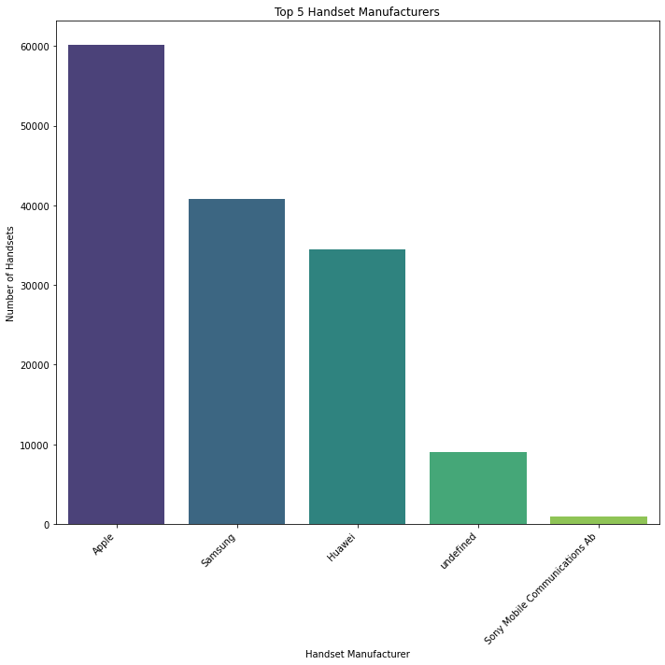
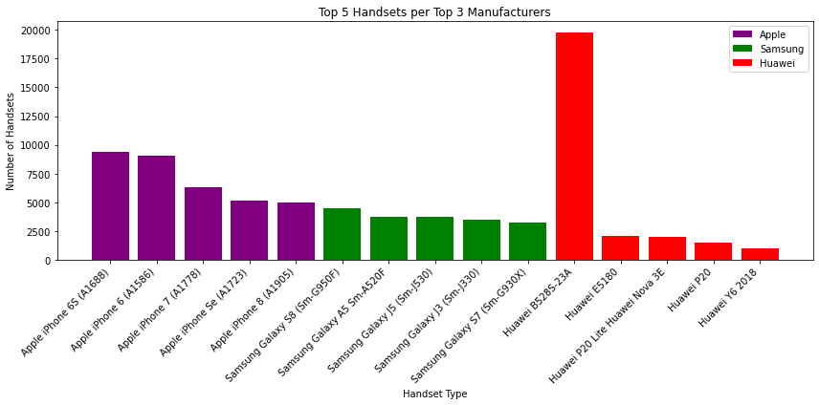
User Overview Analysis
Fig-1
Fig -6
Fig 2
Fig 3
Fig-4
Fig-5
Interpretation:
Top 3 MSISDN/Number based on number of XDR Sessions are 4.1882,3.362632e+10,3.362578e+10 respectively from fig-1
Total session Duration for the Top 3 MSISDN are 7.255100e+07,1 .855375e+07,9.966898e+06 respectively from fig-2
Total Data Volume by top 3 MSISDN/Number are 5.317447e+11,8.846226e+09,8.514774e+09 respectively from fig-3
Top 5 Handset manufacturers present in data set are Apple, Samsung, Huawei, undefined and Sony from fig-4
Huawei B-5285 handset is used by maximum number of users from Fig-5

Slide 6
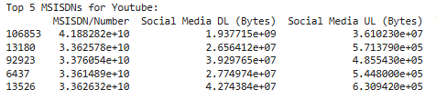
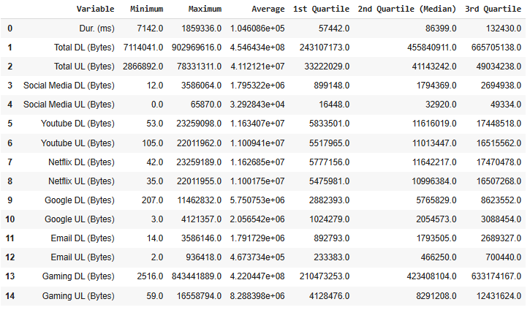
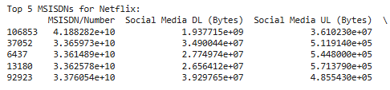
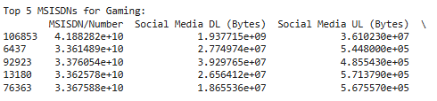
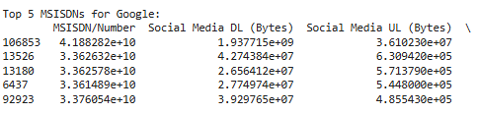
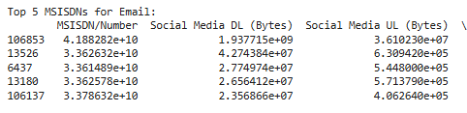
Total data volume (in Bytes) during this session for each application (Social Media, Google, Email, YouTube, Netflix, Gaming)
Non-graphical Univariate analysis- For each of the variables describing the customers, report in a table the minimum value the maximum value, the average, the 1st, 2nd & 3rd quartile and provide reasonable interpretations
Interpretation
"Dur. (ms)" (Session duration): The median session duration is [86399], with a significant range from [7142] to [1859336] milliseconds
"Total DL (Bytes)" (Total Download data): The average download data is [4.54643e+08] bytes, with a large variation seen from [711404] to [902969616] bytes
"Total UL (Bytes)" (Total Upload data): The 3rd quartile for upload data is [49034238] bytes, suggesting that 75% of the users had upload volumes below this value.

Slide 7
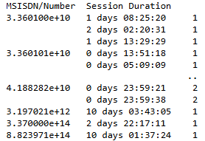
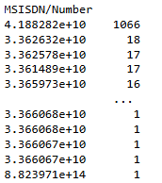
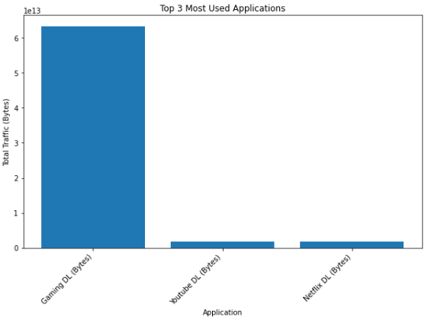
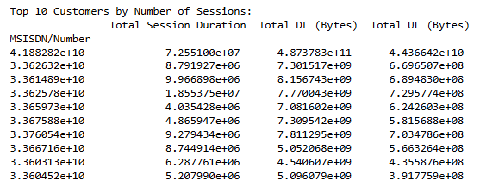
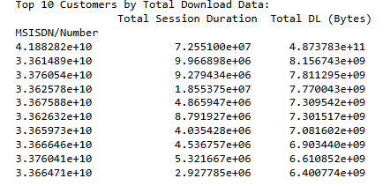
User Engagement Analytics
Duration Of Session
Session Total Traffic
Session Frequency Based on MSISDN /Number
Top 3 most used applications
Fig-1 : 3 Most no of sessions based on MSISDN are 1066,18,17
Fig-2: There are users who used have 10 plus days session durations
Fig-3: Gaming DL is the most used application
Top 10 Engaged Customers Based on Total Session Duration
Top 10 Engaged Customers Based on Total Down Load
Interpretation
Total Traffic comes out to be 74365191220297.38
Top Engaged users based on Total DL are 4.188…e+10 ,3.361…e+10 and 3.37…+10 from fig-5
From Fig-4 top 3 sessions durations are 7.255..e+07,8.79..e+06 and 9.9668..e+06 respectively
Fig-4
Fig-5

Slide 8
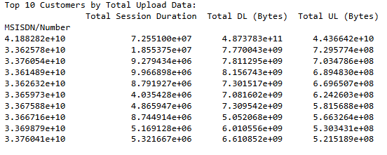
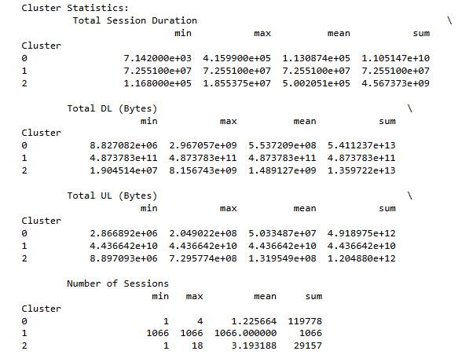
Top 10 Engaged Customers Based on Total Upload
Fig-1
K-means Clustering and group users based on engagement Metrics
Interpretation:
From Fig-1 Total upload by top 3 engaged users are 4.436642e+10,7.295774e+08,7.034786e+08 respectively
From Fig-1 Session duration for the top 3 engaged uploaded users are 7.255100e+07,1.855375e+07 and 9.279434e+06 respectively
Cluster Analysis on Engagement
Cluster 0 appears to represent high-engagement users, characterized by significantly longer total session durations and higher total data download volumes compared to other clusters
Cluster 1 represents moderate engagement, showing intermediate values for session duration and data volume
Cluster 2 shows the lowest engagement levels with the shortest session durations and smallest total data volumes
Fig-2

Slide 9
Key Interpretations and Findings:
Data Volume and Application Usage Correlation:
The code calculates the correlation between total data volume and usage for various applications (e.g., Social Media, YouTube, Netflix).
Finding: The correlation analysis helps identify which applications are most strongly related to higher overall data usage. For example, if YouTube data volume shows a strong positive correlation with total data volume, it suggests that users who consume more YouTube content generally have a higher overall data usage.
Session Duration vs. Data Volume:
Scatter plots are used to analyze the relationship between total session duration and total data volume for the top 6 users (identified by highest data volume).
Finding: The scatter plot helps reveal if there is a positive correlation between session duration and data volume, indicating that users with longer sessions generally use more data. It could also help identify outliers, where users have short sessions but very high data volume, possibly due to large file downloads.
User Segmentation with Deciles:
The code divides users into deciles based on their total data volume.
Finding: This categorization can reveal patterns in data consumption across different user segments. For example, users in the top decile might have very different usage behavior compared to those in the lower deciles.
Principal Component Analysis (PCA):
PCA is applied to reduce the dimensionality of the data and identify underlying patterns.
Finding: PCA helps create new features (principal components) that capture the most important variations in the data. By analyzing the explained variance ratio and loadings, you can gain insights into which original features contribute most to these new features. For example, PC1 might represent overall data usage, PC2 might represent social media usage, etc.
Correlation Matrix of Application Data:
A correlation matrix is generated to understand the relationship between different application data.
Finding: The heatmap of the correlation matrix helps reveal how usage of different applications is linked. For example, if Social Media data and YouTube data have a strong positive correlation, it suggests users who heavily use social media also tend to consume more YouTube content.
Session Frequency Analysis:
The code calculates the frequency of sessions for each user (MSISDN).
Finding: This helps identify the users with the highest number of sessions, which could be considered highly active or engaged users.
Total Traffic Calculation:
The code calculates the total traffic (upload + download) for all users.
Finding: This provides a general overview of the network's total data usage.
Customer Engagement Analysis:
Aggregation per Customer: Metrics like session duration, data volume, and session counts are aggregated per customer (MSISDN).
Top 10 Customers: The top 10 customers based on various engagement metrics are identified.
Normalization and Clustering: Engagement metrics are normalized, and k-means clustering (with k=3) is used to group customers into clusters based on their engagement level.
Cluster Statistics and Interpretation: Statistics like the minimum, maximum, average, and total values are computed for each cluster. Visualizations (e.g., scatter plots) help understand the characteristics of each cluster.
Finding: The clusters reveal insights into user behavior. For example, one cluster might represent high-engagement users, another represents medium-engagement users, and a third represents low-engagement users.
Application Usage by Users:
User total traffic per application is calculated.
Top 10 Users: The top 10 most engaged users for each application are identified.
Top Application Usage: The top 3 most used applications are plotted using a bar chart.
Finding: This helps understand which applications are the most popular among users and which users are the most engaged with each application.
Optimal k for K-Means Clustering:
The elbow method is used to find the optimal number of clusters (3) for k-means.
Finding: The elbow point on the inertia plot suggests the optimal k value, which represents a balance between maximizing variance explained within clusters and minimizing the number of clusters.

Slide 10
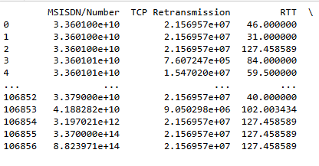
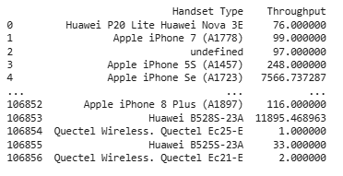
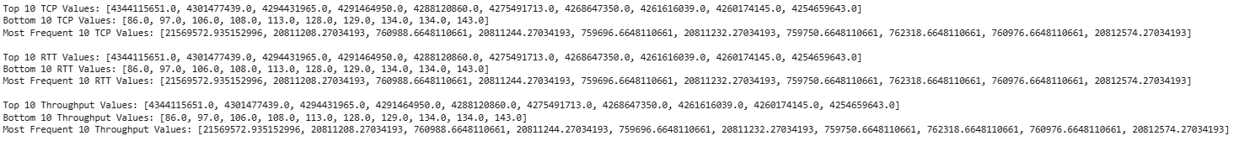
User Experience Analytics
Fig-1 User Segregation Based on TCP Retransmission
Fig-2 Handset Type Based Throughput
Fig-3 Top 10 users Based on Transmission Control Protocol ,Round Trip Time and Through Put
Interpretation
From Fig-2: Huawei B528S, Apple iPhone are with Throughput 11895 and 7566 respectively,
From Fig-1: TCP Retransmission are 2.156957e+05 and 7.607247e+05 for top 2 users , lower retransmission is a better experience for consumer
From Fig -3: RTT Values for top 10 , bottom 10 and most frequent users have been identified ,
Notes:
Aggregate user based on Average TCP Retransmission, Average RTT, Handset Type and Average Through Put
Average RTT, Handset Type and Average Through Put
Distribution and TCP Retransmission per handset
K-means to segment user on group of experience

Slide 11
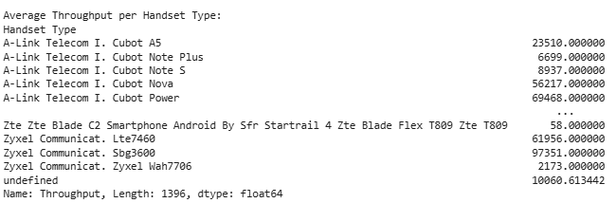
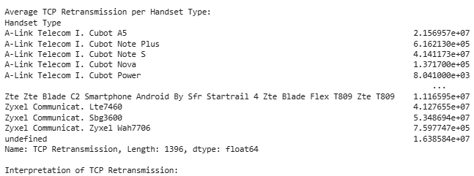
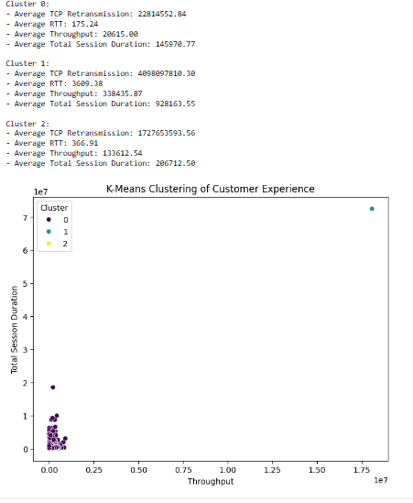
Distribution and TCP Retransmission per handset
Brief description of each cluster based on the data:
#
# Cluster 0:
# - Likely represents users with a good network experience. They have a low average TCP Retransmission rate, indicating fewer packet losses and reliable data delivery. They also have a lower average RTT, meaning there's less delay in data transmission. The average throughput might be moderate to high, suggesting good network speed and capacity. Their total session duration could be moderate.
#
# Cluster 1:
# - Could represent users with a moderate network experience. They might have a slightly higher average TCP Retransmission rate compared to Cluster 0, indicating some network instability or congestion. The RTT could be slightly higher, meaning there are more delays in data transmission. The average throughput could be moderate. Their total session duration could also be moderate.
# Cluster 2:
# - Might represent users with a poorer network experience. They have a higher average TCP Retransmission rate, indicating frequent packet losses or network issues. The RTT is likely higher as well, meaning significant delays in communication. The average throughput could be lower due to network bottlenecks or limitations. Their total session duration could be lower.
K-means to segment user on group of experience

Slide 12
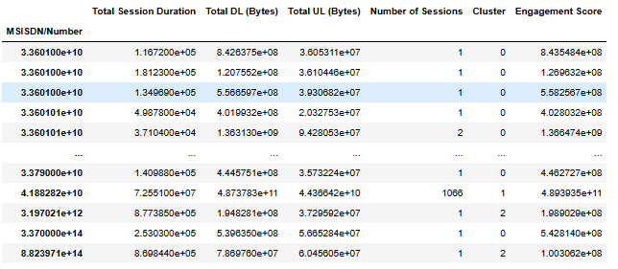
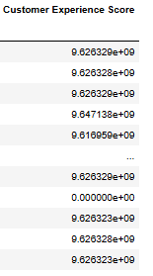
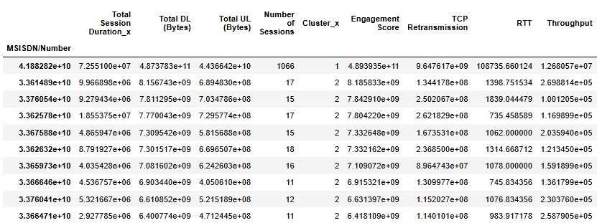
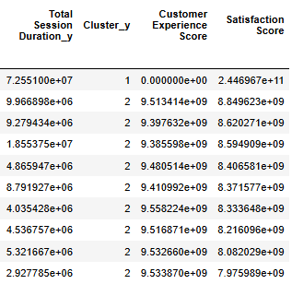
User Satisfaction
Interpretation
Fig-1: Cluster wise experience and engagement score for users were identified
Fig-2: Satisfaction score of users post inner join on experience and engagement score were found cluster wise
Fig-1: Engagement and Experience Score For User
Fig-2: Satisfaction Score of User
Notes:
Engagement and Experience Score For User
Satisfaction Score
K means on Engagement and Experience Score
Aggregate the satisfaction and experience score per cluster

Slide 13
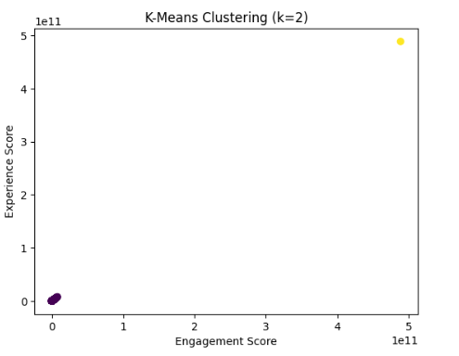
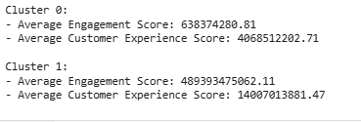
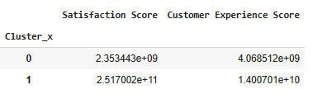
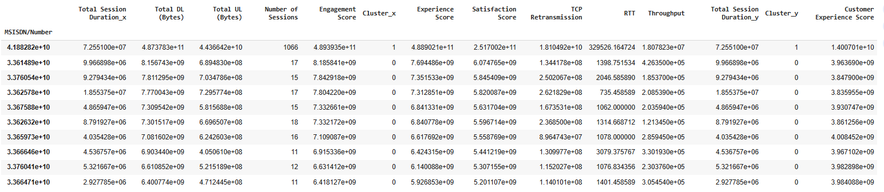
K means on Engagement and Experience Score
Aggregate the satisfaction and experience score per cluster
Top 10 satisfied customer based on Customer Experience Score

Slide 14
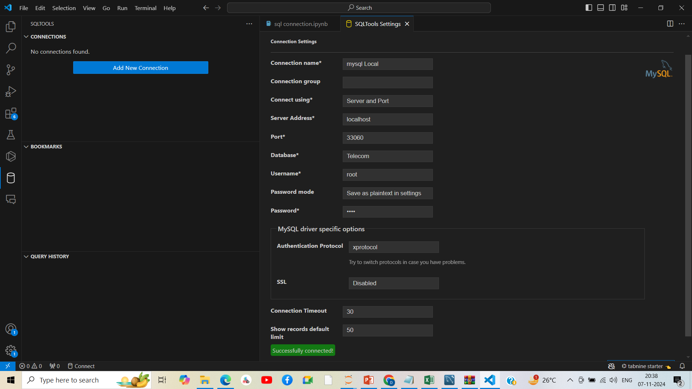
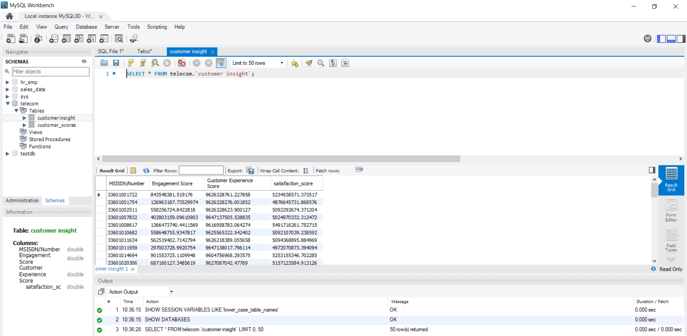
Connection with MYSQL Data Base and Visualization of Data
Fig-1
Fig-2
Customer Insight Data Sheet
Interpretation
Final table containing all user ID + engagement, experience & satisfaction scores was created and stored in Local database.( From Fig-1)
Telecom database was created and customer_insight table was put inside the database with the relevant columns (From Fig-2)
The Data sheet has been attached for reference

Slide 15
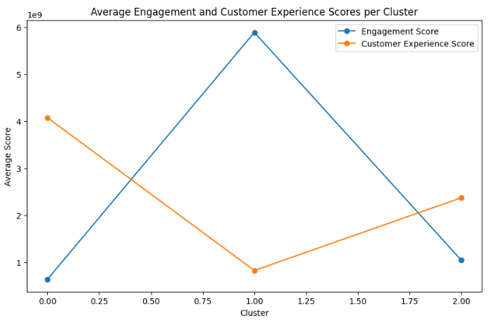
Recommendation And Conclusion
Recommendation
Investor to Focus on the users with high engagement and satisfaction score attached on the customer Insight Data Sheet
Low Engagement and High Satisfaction set of customer need to be dealt for improving engagement
Apple and Huawei customers need to be focused for higher satisfaction and experience
Social Media engagement users apart from Game DownLoad need to be checked for higher experience and engagement
From the above plot cluster 1 users with higher engagement and cluster 0 users with higher customer satisfaction need to be focused
Customer Experience
lower retransmission is a better experience for consumer
Customer Engagement:
Game Down Load application with highest engagement
Fig-1
Customer Satisfaction
Higher Through Put leads to better customer satisfaction
RTT less shows better satisfaction
Customer Behavior
Most users engaged in Game Download
The Huawei B-5285 handset is used by maximum number of users

